Slide 1
HTML Form and Controls II
Week 01.

Slide 2
Objectives
Describe the syntax and characteristics of more HTML form elements;
Demonstrate how to create a form in web page.

Slide 3
FORM ELEMENTS

Slide 4



Label Element
Or

Slide 5



Input Element: Textbox
Notes:
Click on the sentence “Should external links open in new tab?” to open to article.

Slide 6


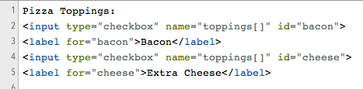

Input Element: Checkbox
Single Option
Multiple Options
Notes:
Click on the sentence “Should external links open in new tab?” to open to article.

Slide 7
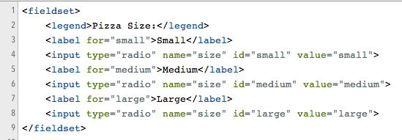
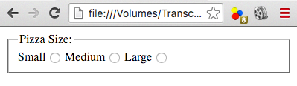
Input Element: Radio Button
Notes:
Click on the sentence “Should external links open in new tab?” to open to article.

Slide 8
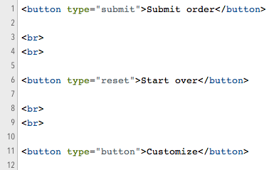
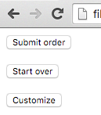
Button Element
Submit Form data
Clear Form data and set them to default value
Customise a button to perform special function. Usually link with a JavaScript function.

Slide 9

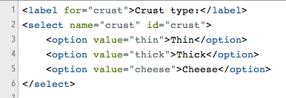
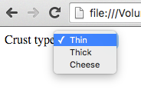
Select Element

Slide 10

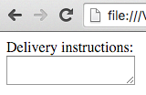
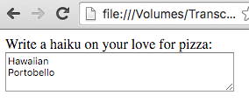

Textarea Element

Slide 11
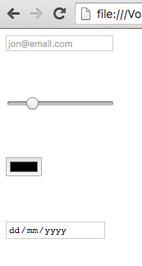
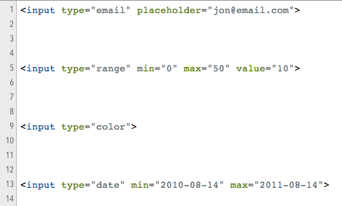
Other Elements in HTML5

Slide 12
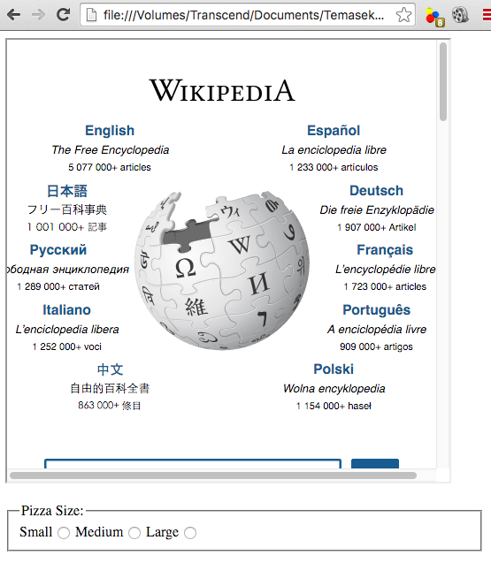
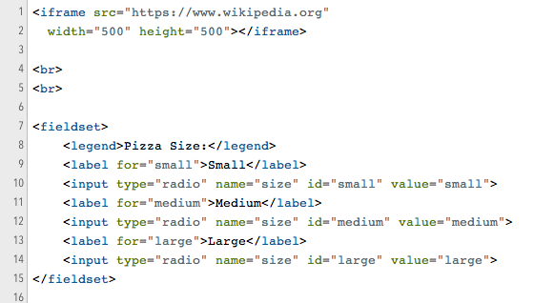
Iframe Element
You can use HTML to embed other webpages in your own page using an iframe element pointing at a URL.

Slide 13
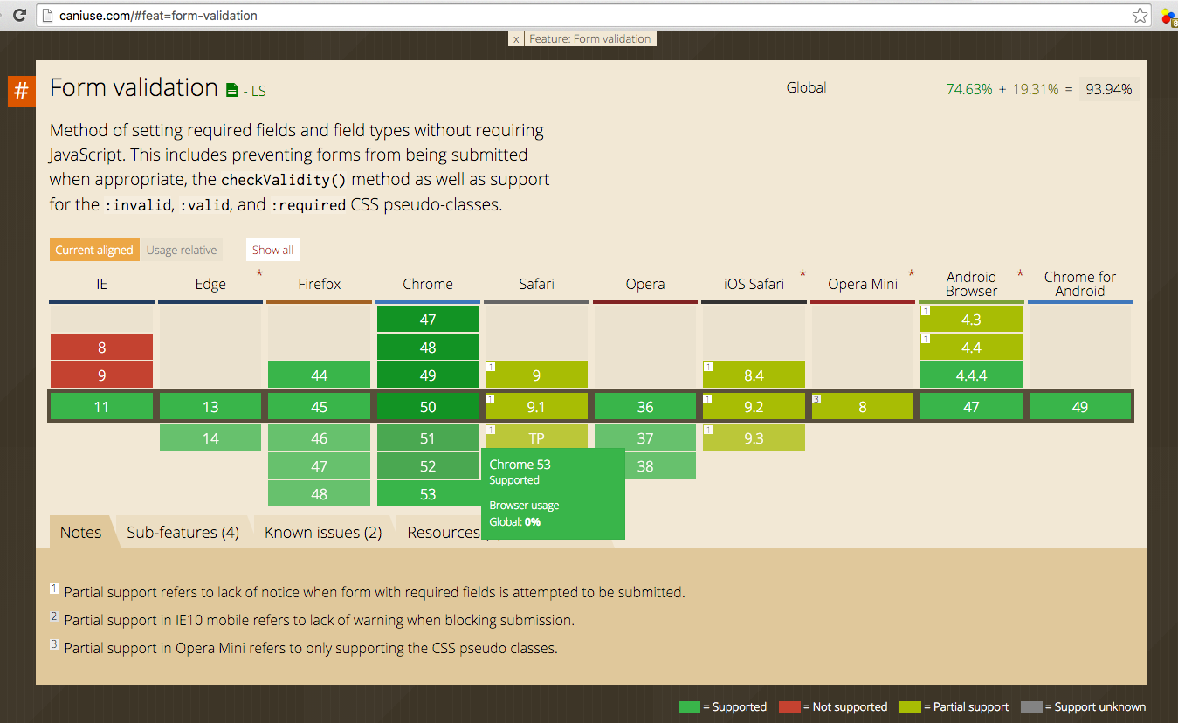
Compatibilities and Support
Various browsers support different features of HTML/CSS/JS.
The following website is useful to check for the support:
http://caniuse.com

Slide 14
challenge
W1.6 HTML Form and Controls II.docx

Slide 15
The End

